Slide 1
Smart Glove : Gesture Translator Project 2
Angela Mwanzia
19ZAD103899
Supervisor: Mr. Matthew Thiong’o
1st April 2021

Slide 2
Introduction
Background Information
This project is about a Smart Glove: Gesture Translator that translates American Sign Language (ASL) alphabets into text and speech.
This project aims at enabling the speech and hearing-impaired people to communicate with those who don't use, need or understand sign language.
The use of the alphabets is to show the possibility of a future glove that can translate whole words that need one hand as well as those that need two through pairing.
The gloves are composed of flex sensors that detect the bending of ones fingers that will read the bends and convert them into angles so as to then convert them into text on a smart phone, which then converts the text into spoken word.
The programming language used in the system is C#.

Slide 3
Hardware
5 Flex Sensors: Used to sense the resistance through the bending of ones fingers.
Jumper wires: Used to connect the Flex Sensors to the breadboard.
Breadboard: Used to ensure a stable connection of the hardware.
Arduino Nano: Used to store code and act as a motherboard for the system.
5 10 k ohms Resistors: Used to earth the flex sensors.
Power Source(Power Bank, USB and battery): Used to power the motherboard.
Bluetooth HC-06 Module: Used to connect the serial monitor to the app.
ADXL Accelerometer : Used to sense the movement of the wrist.

Slide 4
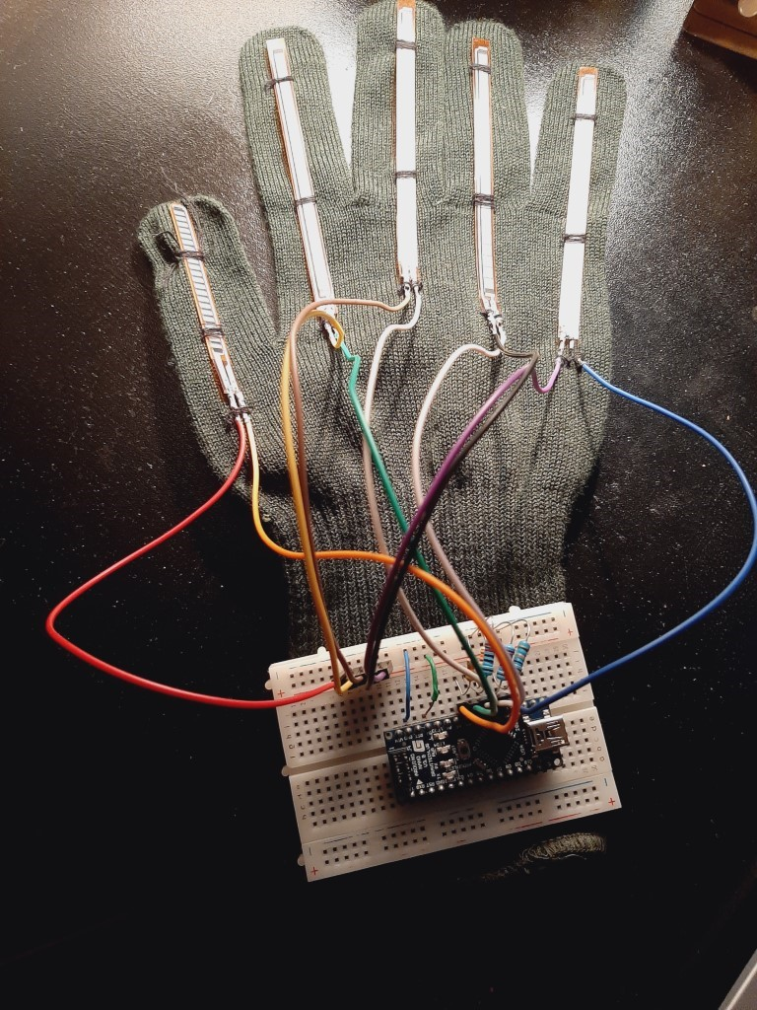
Glove Prototype

Slide 5
Advantages and disadvantages
Advantages | Disadvantages
Opens more doors for new technological advancements in communication. | Costly
in intends to be 99% accurate | Solder interfered with wire during connection
Intends to be cheaper as popularity was | Resistance is not very stable
User Friendly system

Slide 6
Collecting Data
For this project the data collected was the bend of ones figure that was latter converted into angles.
These angles where different for each finger so a combination of five different angles leads to a specific letter.
The angles were all collected in groups based on a particular alphabet.

Slide 7
Collecting data
Hand compressions: Through this I ran through all of the alphabets for each flex-sensor and recorded the flex value for each one. Based on this, I specified the range for each flex sensor between its minimum and maximum observed values.
Hand gestures: These are sensed in XYZ axes. So, I took the XYZ values for all alphabet representations and dispersed them into areas similarly to how I distributed flex sensors into areas.
Contacts between fingers: Sense the interaction between two fingers by forming a closed circuit when they are crossed and an open circuit when they are not crossed. This helps differentiate alphabets with the same flex sensor and accelerometer field values.

Slide 8
Connecting components
Two components make up the Smart Deaf-Mute Glove. Bluetooth is used to communicate with the Detector and Translator units. I developed the project in this manner to provide a safe haven for deaf-mutes when conversing with others. Furthermore, the glove circuit will be light enough to be carried. To highlight this point even more, I designed it as a PCB to be as light as possible by hand.

Slide 9
Detector module
The aim of this module is to detect hand compressions, gestures, and contact between fingers. The data processor was the Arduino Nano, which was controlled by five 4.5-inch Flex sensors, and a GY-61 accelerometer. In addition to the contact sensor circuits. The output of the data processing is an alphabet or a letter, which is sent to the second module through the HC-05 Bluetooth module. The circuit for this module was built in Eagle IDE in order to generate a PCB. A Lithium battery is connected to a step-up converter as the power supply. To obtain the lightest weight, I chose this method of providing voltage.

Slide 10
Translator module
The translator model is made up of an application, a Text-To-Speech module, a speaker, and an HC-06 Bluetooth module linked to an Arduino Nano. This module collects data from the detector module and displays it on the serial monitor before translating it to audio, which is output via a speaker. By adding a 9V battery to the Arduino's Vin pin, I was able to supply voltage to this board.
Since all of the components in both modules need 5V to operate, I powered the Arduinos via the Vin pins and the components via the Arduino VCC pins. Considering the maximum current each module absorbs from the Arduino and the maximum current the Arduino can have on the VCC pins according to the Nano and Mega Arduino documentation. (LearnArduino, 2017)

Slide 11
Sample Code
#include <SoftwareSerial.h>
SoftwareSerial BTSerial(2,3); //RX / TX
const int FLEX_PIN1 = A0;
const float VCC1 = 5;
const float R_DIV1 = 10000.0;
const float flatResistance1 = 25000.0;
const float bendResistance1 = 100000.0;
void setup() {
Serial.begin(9600);
pinMode(FLEX_PIN1, INPUT);
BTSerial.begin(9600);
}
void loop() {
if (BTSerial.available())
Serial.write(BTSerial.read());
if (Serial.available())
BTSerial.write(Serial.read());

Slide 12
Sample code
int flexADC1 = analogRead(FLEX_PIN1);
float Vflex1 = flexADC1 * VCC1 / 1023.0;
float Rflex1 = R_DIV1 * (VCC1 / Vflex1 - 1.0);
//Serial.println("Resistance: " + String(Rflex1) + " ohms");
float angle1 = map(Rflex1, flatResistance1, bendResistance1, 0, 90.0);
//Serial.println("Bend: " + String(angle1) + " degrees");
//Serial.println();
int xadc = analogRead(xpin);
int yadc = analogRead(ypin);
if(((angle1>=70)&&(angle1<=82))&&((angle2>=77)&&(angle2<=90))&&((angle3>=70)&&(angle3<=86))&&((angle4>=73)&&(angle4<=85))&&((angle5>=0)&&(angle5<=45)))
Serial.println('A');
delay (10000);}

Slide 13
The future of smart gloves
1) Further integrated with other programs that will continue to create opportunities for deaf and hard of hearing people.
2) Geared up with the controller to provide home automation on finger tips.
3) Used in combination with a fitness sensor to track the individual’s health.
4) Added words that only need one hand to translate sign language.
5) Paired with another glove together so as to improve the variety of signs that can be done by two hands.
6) Further integrated to be used as a remote control like for a TV, toy car, helicopter, drone and many more.

Slide 14
Results
The converted letters are further converted into speech and displayed on the application.
There is a short video attached.

Slide 15
Conclusion
To conclude, society is increasingly evolving and gravitating toward technological know-how. Technology is not a static or obsolete field; rather, one that is rapidly changing, with new trends emerging on a daily basis. It is beyond time for us to shift towards trends that evolve and improve rapidly. The use of the Smart Glove: Gesture Translator is important for fast communication between non-verbal and verbal people. Therefore, this will help in decreasing the communication barrier.
Also, this project focuses on the ASL alphabets as a means to enable the use of words that form sentences based on signs through measuring the bend of a person's fingers.

